Slide 1

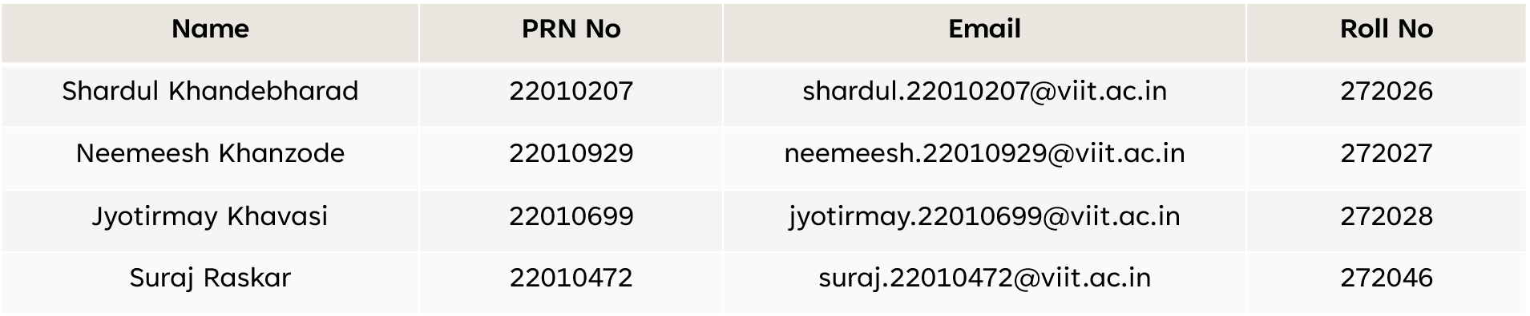
ADUA21204:Database Management System
A project on ‘Movie Ticket Management System’
ACADEMIC YEAR: 2021-22 SEMESTER: III BATCH: B2
Submitted for fulfilment of Project Based Learning by :

Slide 2
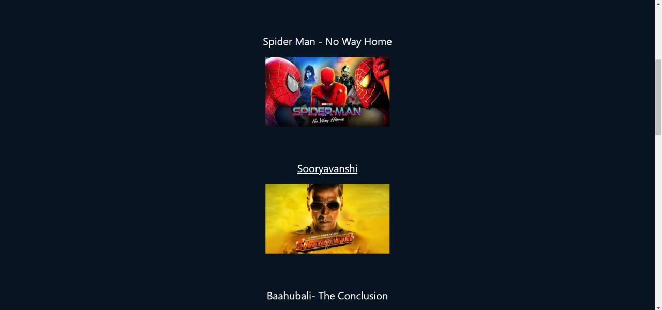
Introduction
Book movie tickets.
Add or set shows by management of cinemas.
Add movies by admin.

Slide 3



Project Category And tools
Web based application
Created using
Django-python
My-SQL
HTML

Slide 4
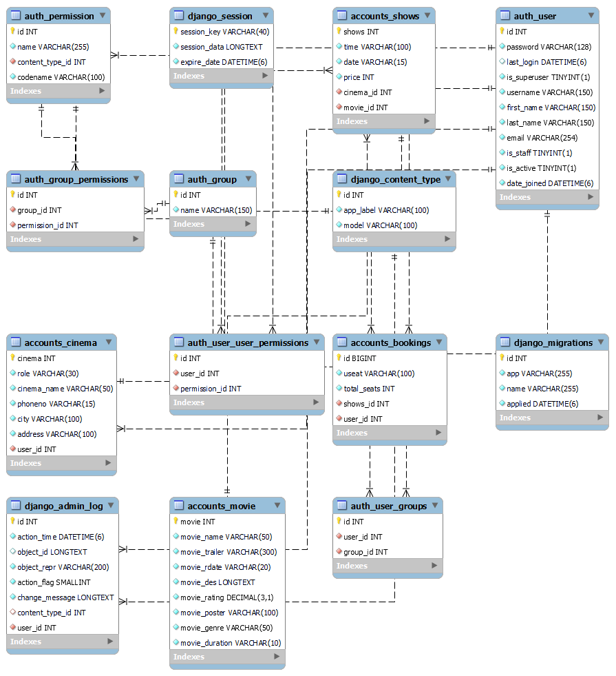

Slide 5
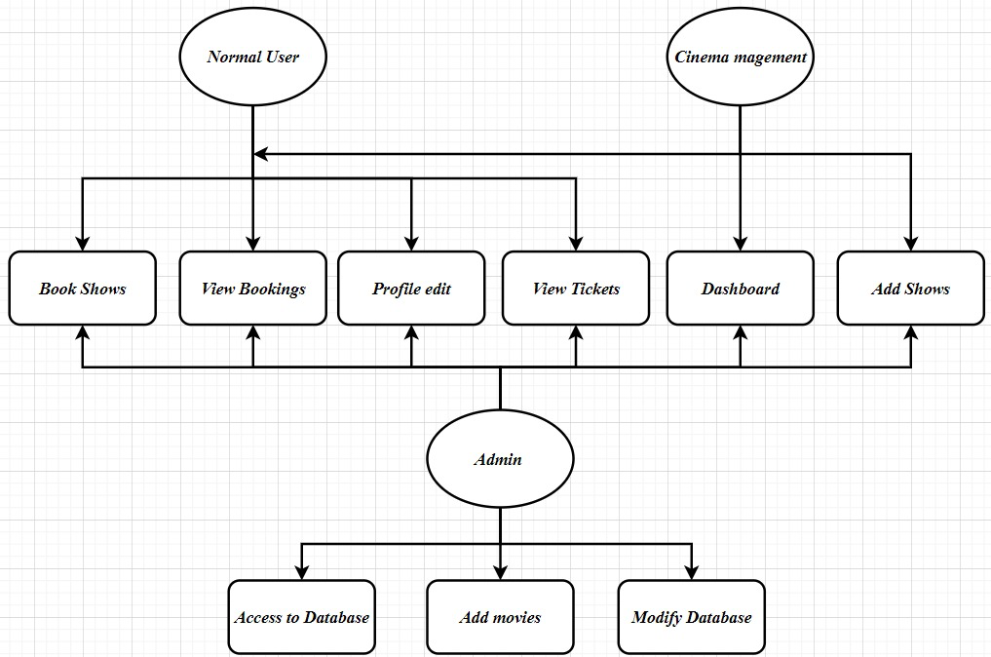
Use Case Diagram

Slide 6
Future Scope
Payment Gateway
Directions
Review forum
Movie prediction and recommendation
City-wise users and theatres
Pre-bookings of snacks

Slide 7

Thank You

